Slide 1
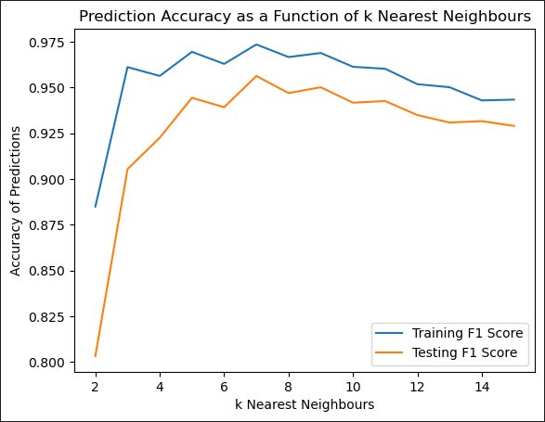
3. Imputation Testing – K- Nearest Neighbour
Nursery Dataset
Base Train
10% missing values
40% missing values
Base Test
70% Missing Values
Naïve Bayes Imputation
Naïve Bayes Imputation
Naïve Bayes Imputation
Mode Imputation
Mode Imputation
Mode Imputation

Slide 2
3. Imputation Testing – K- Nearest Neighbour
Nursery Dataset
Base Train
10% missing values
40% missing values
Base Test
70% Missing Values
Naïve Bayes Imputation
Naïve Bayes Imputation
Naïve Bayes Imputation
Mode Imputation
Mode Imputation
Mode Imputation

